Slide 1
Key Stage 1 National Curriculum
Assessments
A School Presentation to Parents
Information and Guidance on the Expectations for 2018/19

Slide 2
click to see all text
The SAT Assessments
At the end of Year 2, children will take assessments in:
Reading
Maths
We have decided not to administer the optional English: Grammar, Punctuation and Spelling SAT assessment. We will assess grammar, punctuation and reading through teacher assessment of writing.
All assessments are due to take place in May this year.
At the end of Year 2, children will take assessments in:
Reading
Maths
Your child’s school may also decide to administer the optional English: Grammar, Punctuation and Spelling SAT assessment in order to inform their teacher-assessed level in Writing.
All assessment are due to take place in May this year.
chapter
menu
next page

Slide 3
click to see all text
Reading
The Reading Test consists of two separate papers:
Paper 1 – consists of a combined reading prompt and answer booklet. The paper includes a list of useful words and some practice questions for teachers to use to introduce the contexts and question types to pupils. The test takes approximately 30 minutes to complete, but is not strictly timed.
Paper 2 – consists of an answer booklet and a separate reading booklet. There are no practice questions on this paper. Teachers can use their discretion to stop the test early if a pupil is struggling. The test takes approximately 40 minutes to complete, but is not strictly timed.
The texts will cover a range of poetry, fiction and non-fiction.
The Reading Test consists of two separate papers:
Paper 1 – consists of a combined reading prompt and answer booklet. The paper includes a list of useful words and some practice questions for teachers to use to introduce the contexts and question types to pupils. The test takes approximately 30 minutes to complete, but is not strictly timed.
Paper 2 – consists of an answer booklet and a separate reading booklet. There are no practice questions on this paper. Teachers can use their discretion to stop the test early if a pupil is struggling. The test takes approximately 40 minutes to complete, but is not strictly timed.
The texts will cover a range of poetry, fiction and non-fiction.
chapter
menu
next page

Slide 4
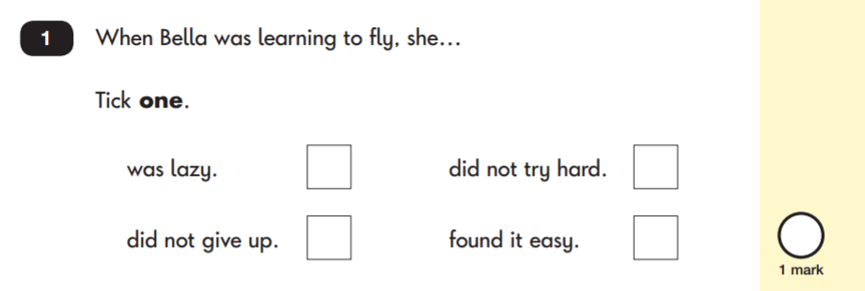
Reading: Sample Questions
Questions are designed to assess the comprehension and understanding of a child’s reading.
There are a variety of question types:
Multiple Choice
chapter
menu
next page

Slide 5
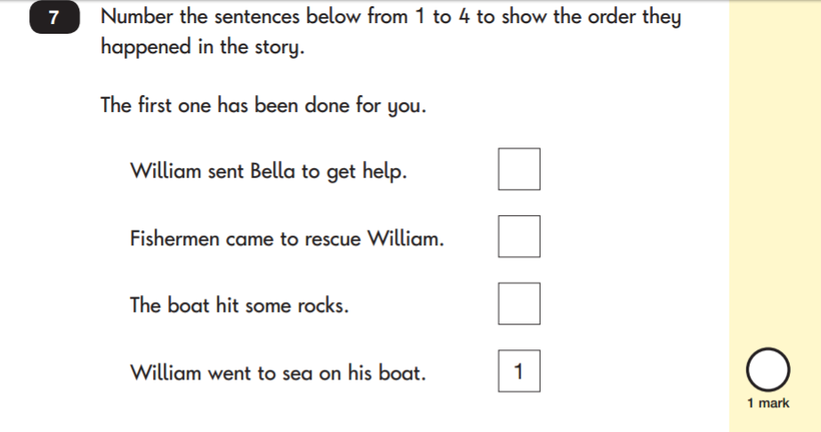
Reading: Sample Questions
Ranking/Ordering
chapter
menu
next page

Slide 6
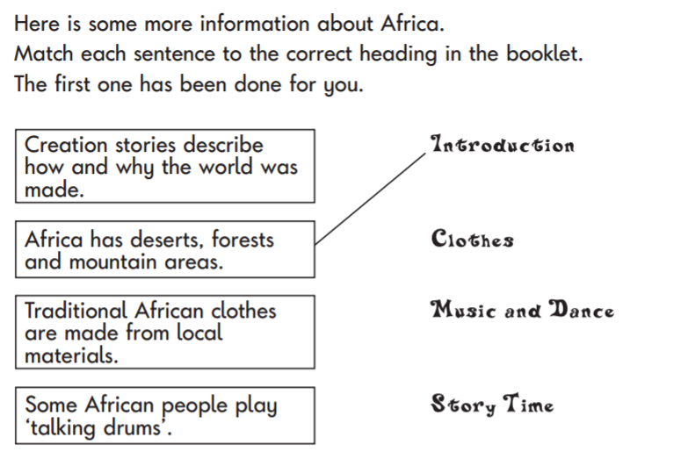
Reading: Sample Questions
Matching/Labelling
Short-Answer Questions
chapter
menu
next page

Slide 7
click to see all text
Reading: Sample Questions
Find and Copy Questions
Open-Ended Questions
chapter
menu
next page

Slide 8
Mathematics
Children will sit two tests: Paper 1 and Paper 2:
Paper 1: Arithmetic - lasts approximately 20 minutes (but this is not strictly timed). It covers calculation methods for all operations.
Paper 2: Reasoning - lasts for approximately 35 minutes, which includes time for five aural questions. Pupils will still require calculation skills and questions will be varied including multiple choice, matching, true/false, completing a chart or table or drawing a shape. Some questions will also require children to show or explain their working out.
chapter
menu
next page

Slide 9
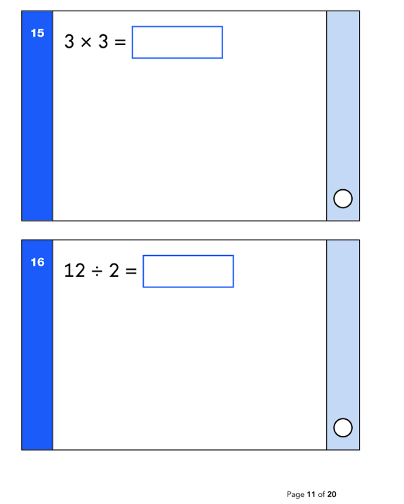
Mathe: Sample Questions
Maths Paper 1: Arithmetic
chapter
menu
next page

Slide 10
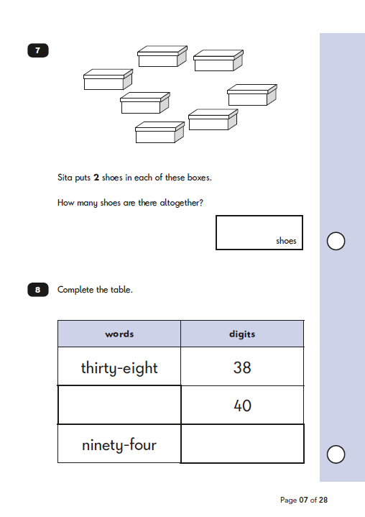
Maths: Sample Questions
Maths Paper 2: Reasoning
chapter
menu
next page

Slide 11
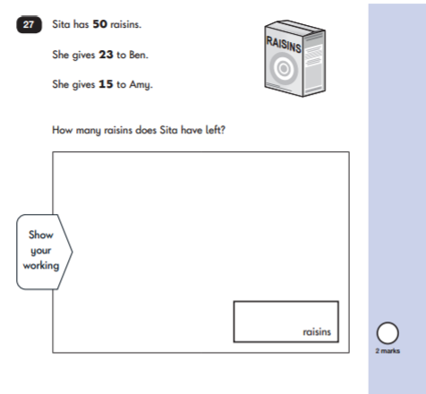
Maths: Sample Questions
Maths Paper 2: Reasoning
chapter
menu
next page

Slide 12
click to see all text
How to Help Your Child
First and foremost, we would appreciate it if you refrain from talking about “tests”. We will talk about it being year two work. If they do seem anxious, support and reassure your child that there is nothing to worry about and that they should always just try their best. Praise and encourage! If we get it right, they shouldn’t even know they are doing the tests!
Ensure your child has the best possible attendance at school.
Support your child with any homework tasks.
Reading, spelling and arithmetic (e.g. times tables) are always good to practise.
Talk to your child about what they have learnt at school and what book(s) they are reading (the character, the plot, their opinion).
Make sure your child has a good sleep and healthy breakfast every morning!
First and foremost, support and reassure your child that there is nothing to worry about and that they should always just try their best. Praise and encourage!
Ensure your child has the best possible attendance at school.
Support your child with any homework tasks.
Reading, spelling and arithmetic (e.g. times tables) are always good to practise.
Talk to your child about what they have learnt at school and what book(s) they are reading (the character, the plot, their opinion).
Make sure your child has a good sleep and healthy breakfast every morning!
chapter
menu
next page

Slide 13
click to see all text
How to Help Your Child with Reading
Listening to your child read can take many forms:
First and foremost, focus on developing an enjoyment and love of reading. Visit your local library; it’s free!
Enjoy stories together – reading stories to your child is equally as important as listening to your child read.
Read a little at a time but often, rather than rarely but for long periods of time!
Talk about the story before, during and afterwards – discuss the plot, the characters, their feelings and actions, how it makes you feel, predict what will happen and encourage your child to have their own opinions.
Encourage children to think about what a ‘tricky’ word could be. Ask them to look at the first letter of the tricky word, then miss it out and read onto the end of the sentence. Then think about ‘what would make sense’ to work out what the word could be. Encourage your child not to ignore those tricky words but instead spend some time trying to work out what they could be.
All reading is valuable – it doesn’t have to be just stories. Reading can involve poetry, newspapers, magazines, football programmes, leaflets and TV guides.
Listening to your child read can take many forms:
First and foremost, focus developing an enjoyment and love of reading.
Enjoy stories together – reading stories to your child is equally as important as listening to your child read.
Read a little at a time but often, rather than rarely but for long periods of time!
Talk about the story before, during and afterwards – discuss the plot, the characters, their feelings and actions, how it makes you feel, predict what will happen and encourage your child to have their own opinions.
Look up definitions of words together – you could use a dictionary, the Internet or an app on a phone or tablet.
All reading is valuable – it doesn’t have to be just stories. Reading can involve anything from fiction and non-fiction, poetry, newspapers, magazines, football programmes, TV guides.
Visit the local library - it’s free!
chapter
menu
next page

Slide 14
click to see all text
How to Help Your Child with Writing
Practise and learn weekly spelling lists – make it fun!
Encourage opportunities for writing, such as letters to family or friends, shopping lists, notes or reminders, stories or poems.
Write together – be a good role model for writing.
Encourage your child to read back and check their spelling. Does the word look right? If it doesn’t encourage them to write a couple of other attempts to see if they can spell it correctly. They need to choose one, so ask for 3 attempts and then choose the one that looks the best. The children won’t always have access to spellchecker or dictionaries so we need to encourage independent strategies that they can use.
Remember that good readers become good writers! Identify good writing features when reading (e.g. vocabulary, sentence structure, punctuation).
Show your appreciation: praise and encourage, even for small successes!
Practise and learn weekly spelling lists – make it fun!
Encourage opportunities for writing, such as letters to family or friends, shopping lists, notes or reminders, stories or poems.
Write together – be a good role model for writing.
Encourage use of a dictionary to check spelling.
Allow your child to use a computer for word processing, which will allow for editing and correcting of errors without lots of crossing out.
Remember that good readers become good writers! Identify good writing features when reading (e.g. vocabulary, sentence structure, punctuation).
Show your appreciation: praise and encourage, even for small successes!
chapter
menu
next page

Slide 15
click to see all text
How to Help Your Child with Maths
Play times tables games.
Play mental maths games including counting in different amounts, forwards and backwards.
Encourage opportunities for telling the time.
Encourage opportunities for counting coins and money e.g. finding amounts or calculating change when shopping.
Look for numbers on street signs, car registrations and anywhere else.
Look for examples of 2D and 3D shapes around the home.
Identify, weigh or measure quantities and amounts in the kitchen or in recipes.
Play games involving numbers or logic, such as dominoes, card games,
draughts or chess.
Play times tables games.
Play mental maths games including counting in 2s, 5s, 10s and 3s, forwards and backwards.
Count on and back in 10s from any number (4, 14, 24, 34, 44, 54 e.t.c)
Encourage opportunities for telling the time (o’clock, half past, quarter to, quarter past and then to 5 minutes)
Encourage opportunities for counting coins and money e.g. finding amounts or calculating change when shopping.
Look for examples of 2D and 3D shapes around the home. Can they identify them?
Identify, weigh or measure quantities and amounts in the kitchen or in recipes.
Play games involving numbers or logic, such as dominoes, card games,
draughts or chess.
chapter
menu
next page

Slide 16
Thank You for your time!
Any Questions, please just ask.

